Slide 1
MycroForest - Exploring the use of a microworld to teach about economic viability of climate aware forest management.
Gayathri Girish Nair Course: MSc. Computer Science

Slide 2
Background (i)
AREA OF INTEREST
Carbon emissions & climate change.
Role of forests as carbon sinks.
Teaching about challenges associated with staying climate aware while ensuring economic viability.

Slide 3

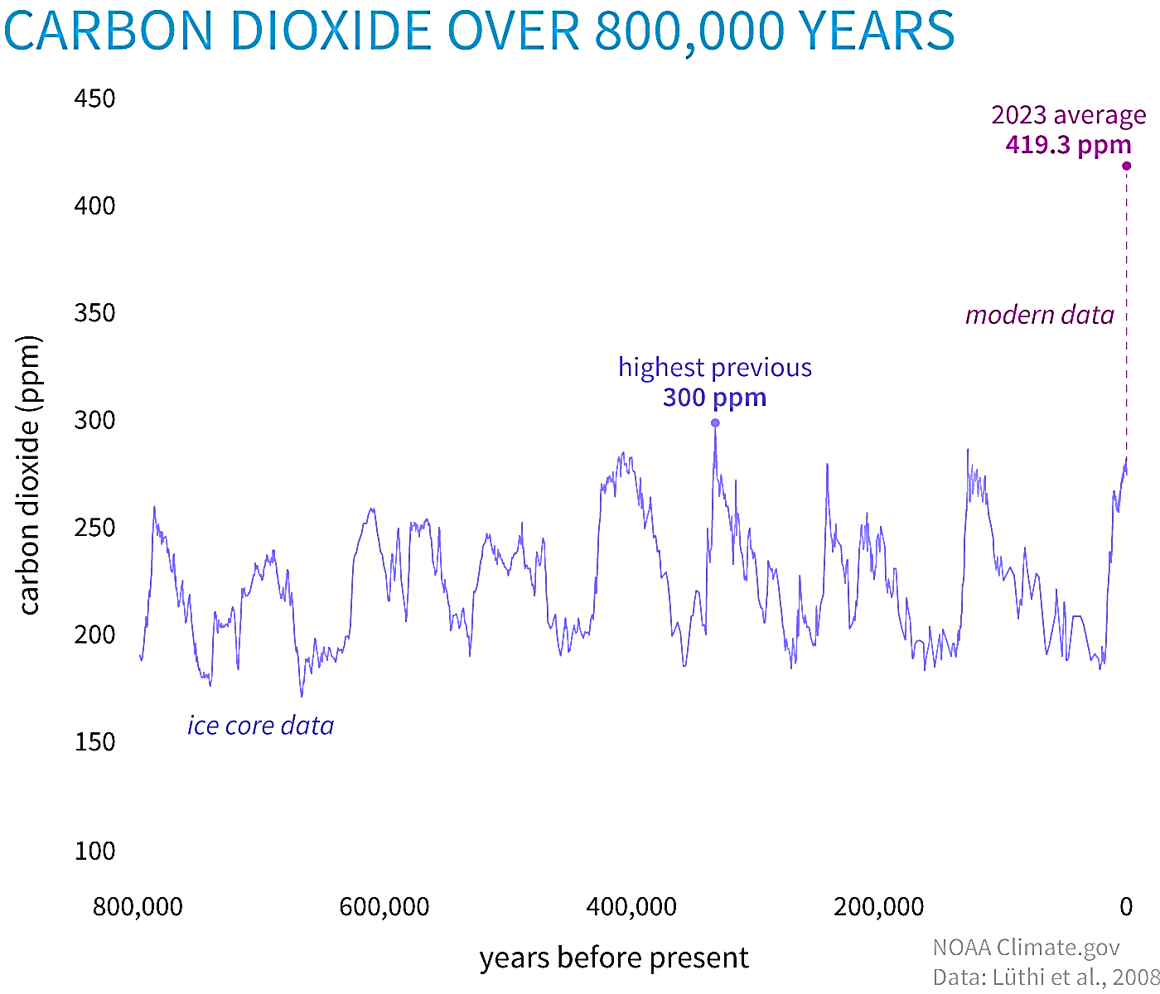



Background (ii)
USA 43°C (2024) [1]
https://www.climate.gov/media/15993
CO2: Important Greenhouse Gas
CLIMATE CHANGE
Extreme Climate: Heatwaves, Floods, Wildfires, Storms …
Disruption of Industry: Agriculture, Energy, Infrastructure …
Health Risks
NEED TO EDUCATE & INSPIRE RIGHT ACTION
MEXICO 51.9°C (2024) [2]
CO2 Conc. In Air = ↑ rapidly
EUROPE (2023) was the hottest year on record [3]
INDIA 52.3 °C (2024) [4]
Human Evolution
CO2 = 200 – 300 ppm
Now (22 June 2024)
CO2 = 427 ppm
Forests absorb 30% of global
emissions per year [6] but are fragile.
UN SDG GOAL 4
High demand for wood [7].
Pre-Industrial
CO2 = 280 ppm
Dangerous
CO2 = 430 ppm [5]
FORESTS

Slide 4
Related Work
EXISTING TOOLS
Either scientifically accurate decision-making aids or more abstract yet informative educational games, often with a collaboration element and some reference to climate change.
Most cater towards adults with few focussing on younger audiences.
Most tackle multiple problems at once such as land use changes as well as forest management along with resource management, which while informative, may be distracting and/or overwhelming, especially for young learners.
To the best of knowledge yet, none that explicitly associates forest management and CO2 levels in the atmosphere and thus global warming while also considering economic viability of the forest.

Slide 5
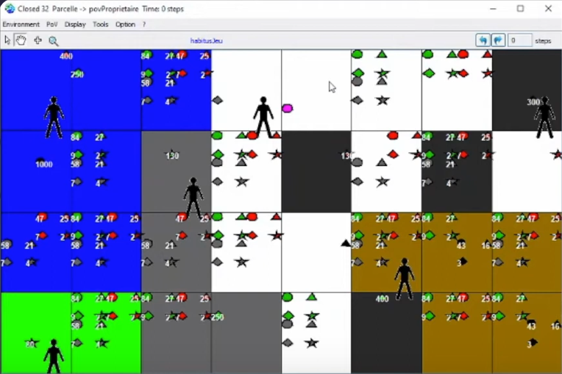
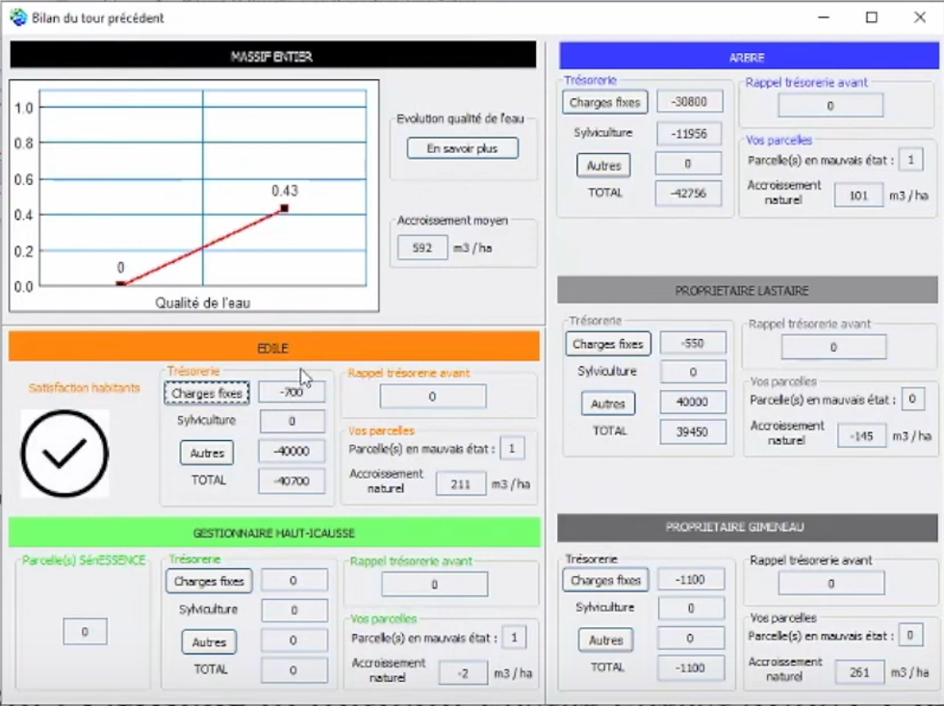
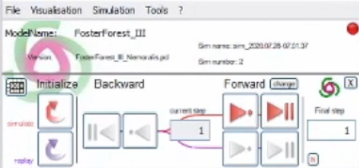
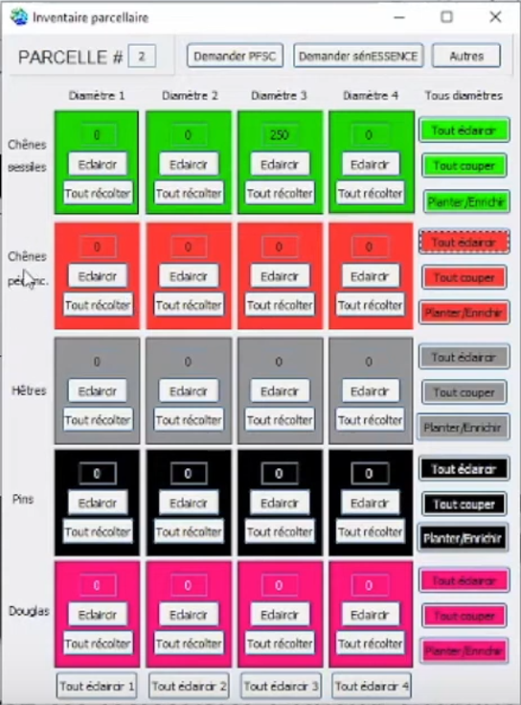
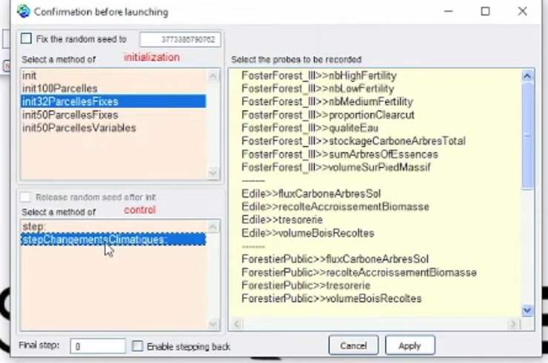
Related Work (ii)
FOSTER FOREST – Decision Making Aid
A 5 expert players + 1 facilitator, role-playing game that simulates forestry under changing climatic conditions.
PROS: ComMod, very engaging, realistic ecosystem model, rich variety of important scenarios (water quality upkeep, land use results, carbon sequestration, species conservation, etc.).
CONS: Very high learning curve (2 usage videos, 6 booklets). Very difficult to use with young or non-expert audiences. Need for elaborate set up (2 projectors + 1 expert facilitator), an expert facilitator, UI is not very user friendly, lacks feedback upon climate changes.
[8]

Slide 6
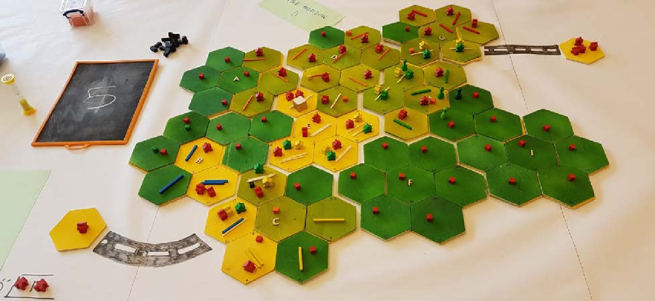
Related Work (iii)
In 2023, P. O. Waeber et. al. tried this game with Forestry graduate students online via a zoom call. THEY confirm good engagement, a great learning experience, and emergence of realistic strategies. There is a need for a fully digital version of this and/or similar games for use as widely accessible, effective, transformative learning tools. [10]
MINE SET – Educational Game
A role-playing board game where players act as CEOs of logging or mining companies and interact with markets, the government, and NGOs to develop strategies which alter land use as measured in terms of forest cover, biodiversity, and volumes traded. The underlying model captures all main drivers of land use change in central African forests (demographics, economical, governance, technological, cultural) via simple rules. [9]
PROS: ComMod, engaging, captures rich variety of land use change drivers, model progression, immersive.
CONS: Allegorical model, (not scientifically accurate), significant set up needed.

Slide 7
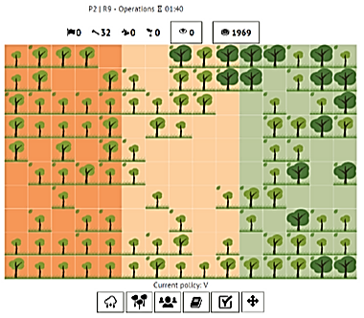
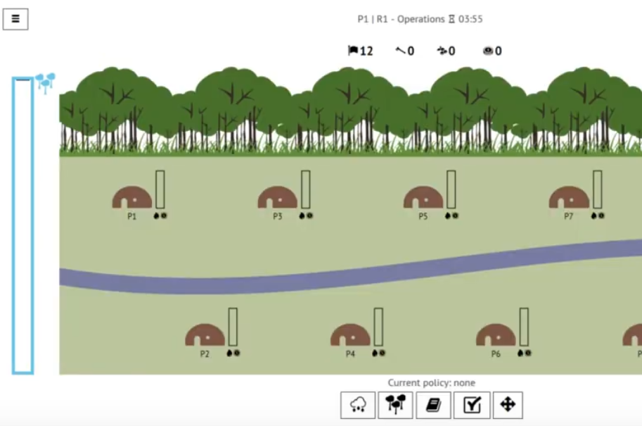
Related Work (iv)
ABOUT THAT FOREST – Educational Game
Web Based multi-player RPG where learners play as forest dwellers who draft and vote on policies to decide on harvesting trees or selling non-timber forest products to make money. Players can also plant new trees and monitor others. The environment reciprocates poor health of the forest via floods that lead to loss for all community members.
PROS: ComMod, engaging, competition v/s cooperation, Explores Economic Driver of Exploitation, widely accessible, appeals to a wider age group and range of starting knowledge level.
https://games4sustainability.org/gamepedia/about-that-forest/

Slide 8
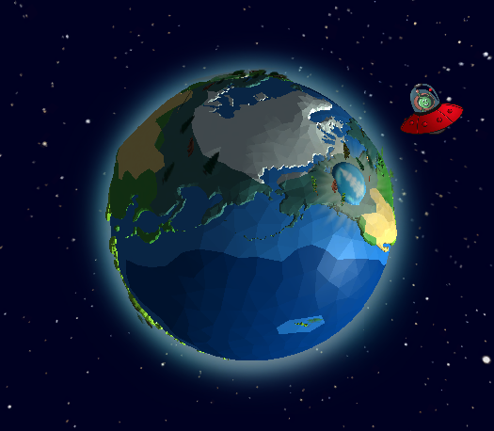
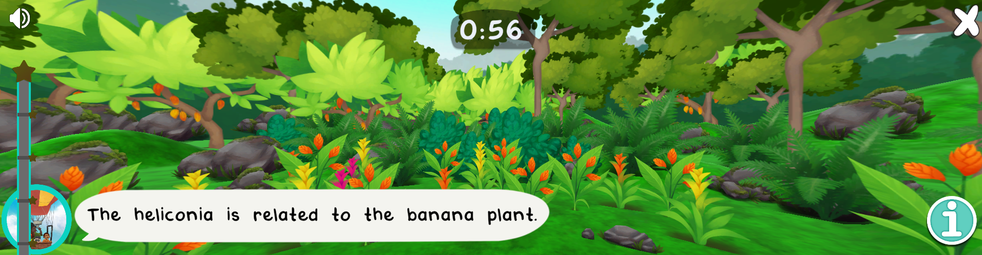
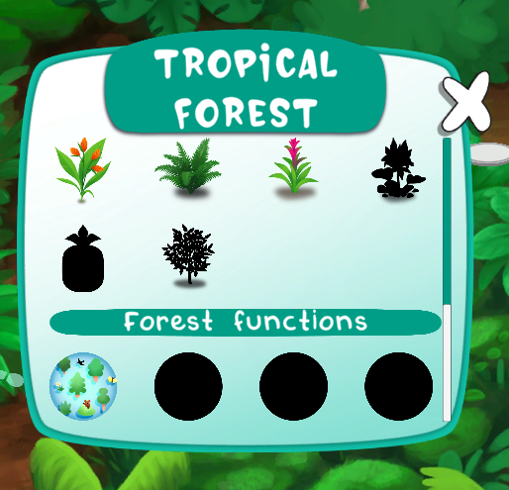
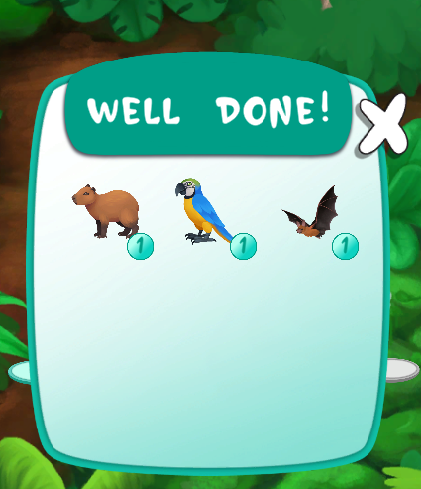
Related Work (v)
FOREST KIDS – Educational Game
Web based game for children where they visit different types of forests and can discover various flora and fauna along with services that the forest offers. Contains fun mini games like picture matching and biodiversity spotting. Provides short fun facts. Learners earn points and can collect spotted species.
https://www.esa.int/Education/Forest_Kids_game_on_biodiversity_now_available
PROS: Very engaging, rich variety of activities, very user friendly, suitable for young children, lots of in-app help in small amounts, visually attractive.

Slide 9
Related Work (vi)
X
No explicit in-app team mode. But learning activity set in teams.
COMPARISON
✘
✘
Allegorical representation of carbon cycle and
real-world plant growth behaviour. Focus is on why. Not how.
X

Slide 10
Educational Approach
Microworld → Good Engagement, Constructivist Thinking
Targets, Challenges → Structure, Problem Based Learning
Competition Among Teams → Gamification, Motivation
Debriefing → Reflective Learning, Inquiry Based Learning
Facilitator → Structure, Guidance, Inquiry Based Learning
Graphical Feedback + Short Explanations → High Effectiveness
Model Progression → Lowers Entry Threshold
[12] [13] [14] [15]

Slide 11
MycroForest Approach (i)
SIMPLE
USER FRIENDLY
INFORMATIVE
FORESTS = CARBON SINK
FOR YOUTH
CLIMATE CONSCIOUS TIMBER HARVESTING = CHALLENGE
Own a virtual forest that controls the microworld’s carbon cycle.
Draft forest management plans: Choose a management action by picking 1. the action type (plant / fell) 2. the tree type (age, species) 3. no. of trees affected 4. year at which to execute action. 5. Whether or not to repeat the action every harvest rotation. Execute your plans. View consequences. Edit. Save. Load.
Set C emissions due to fossil fuel usage.
Always view atmospheric CO2 concentration.
Always view wealth (bank balance, income, expenses).
Toggle on/off other income streams (non-timber forest products, forest recreation).
Set CO2 and income targets. Challenge yourself to meet them.
View consequences of decisions (indicators = atmospheric CO2 levels, biodiversity score, land content).
FUNCTIONAL REQUIREMENTS

Slide 12
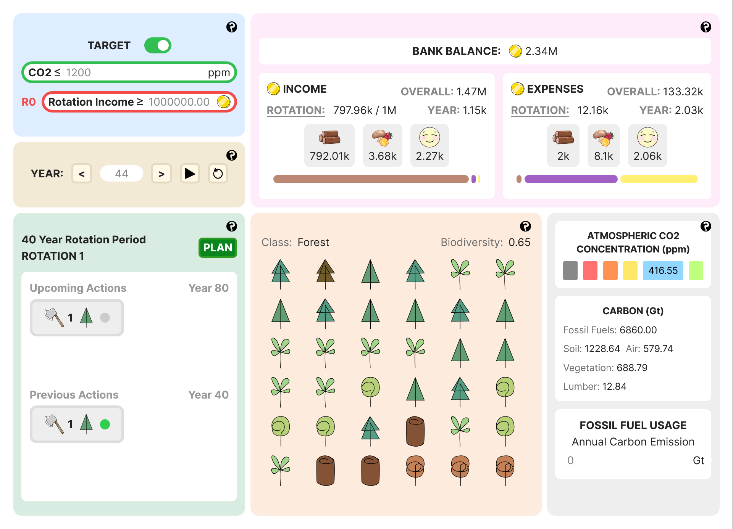
Design (i)
CURRENT APP (Home Page)

Slide 13
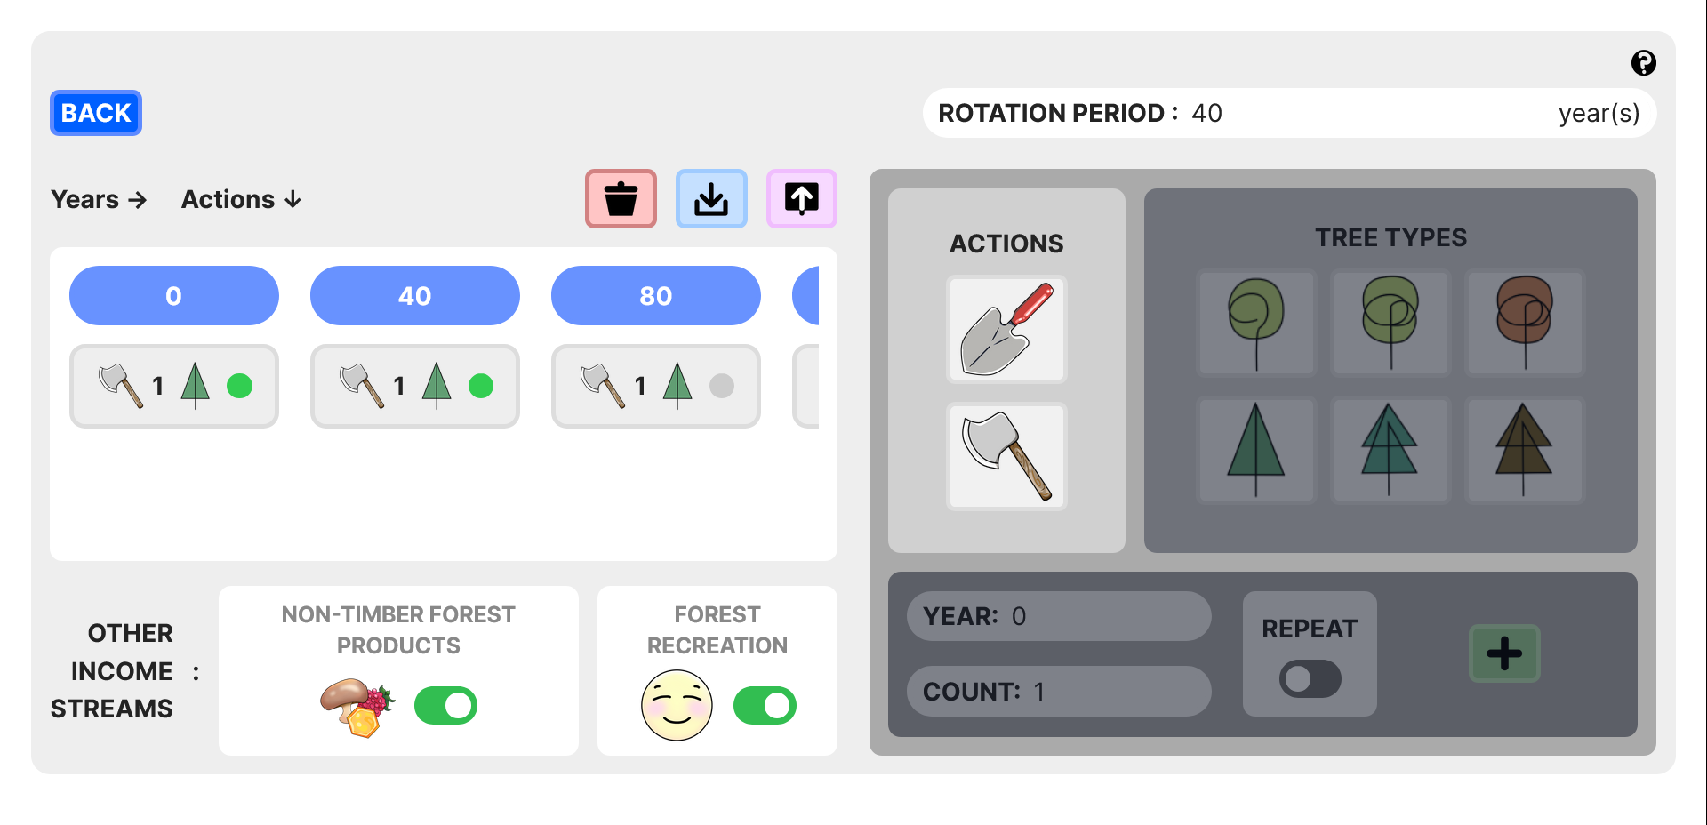
Design (ii)
CURRENT APP (Planning Page)

Slide 14
Design (iii)
SOME CHANGES OVER TIME

Slide 15
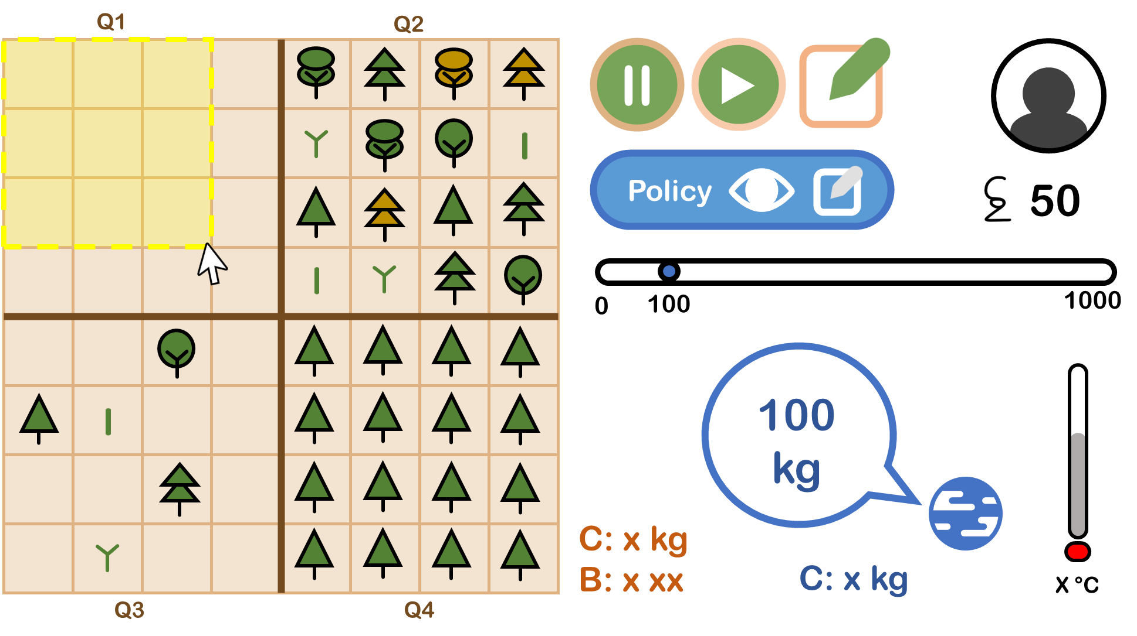
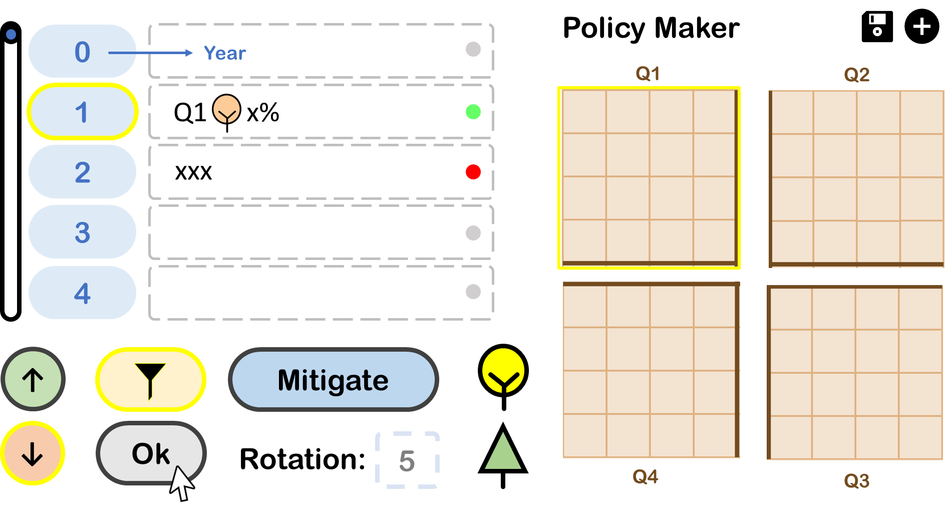
Design (iv)
MOCKUP 1
(MS Power Point)

Slide 16
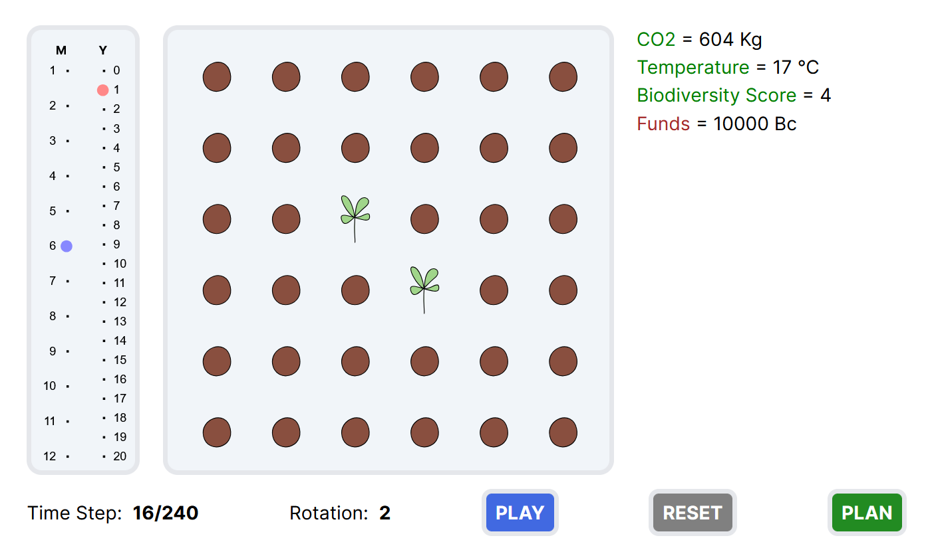
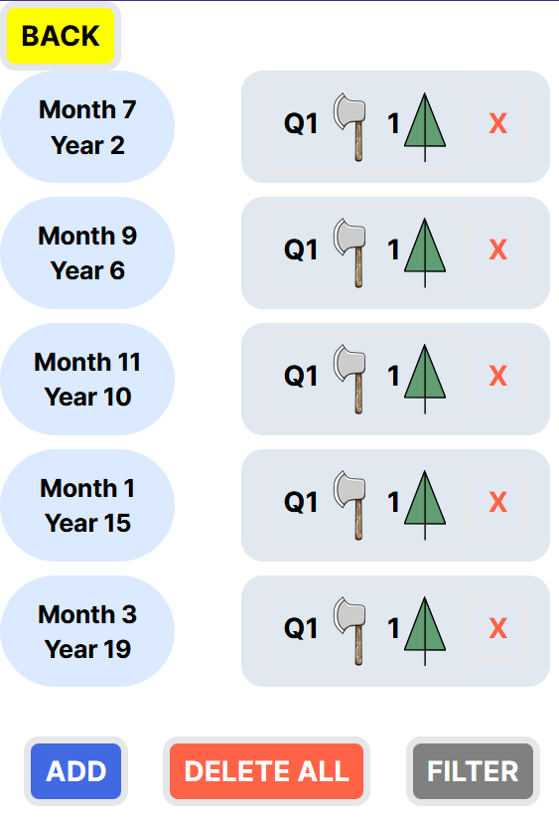
Design (v)
PROTOTYPE 1 (Web)

Slide 17

Design (vi)
https://www.figma.com/proto/Wmpkm80wpOe5lTfVKL0B9V/Mockup?node-id=0-1&t=R0TNsFjvVC2MEEUk-1
MOCKUP 2 (Figma)

Slide 18
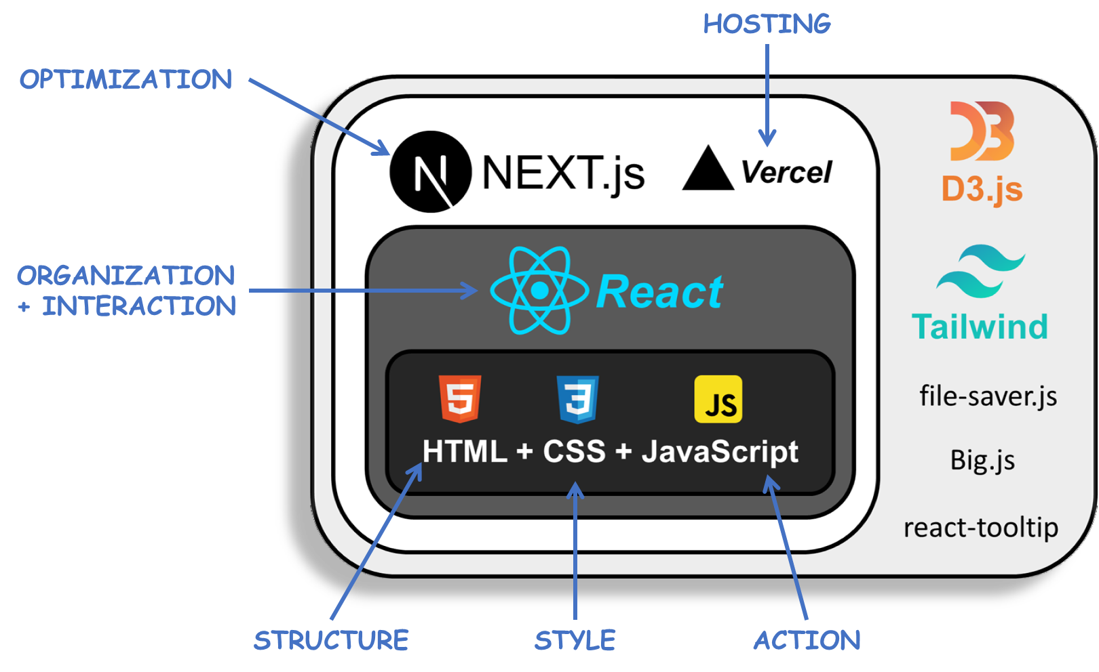
Design (vii)
TECHNICAL ARCHITECTURE

Slide 19
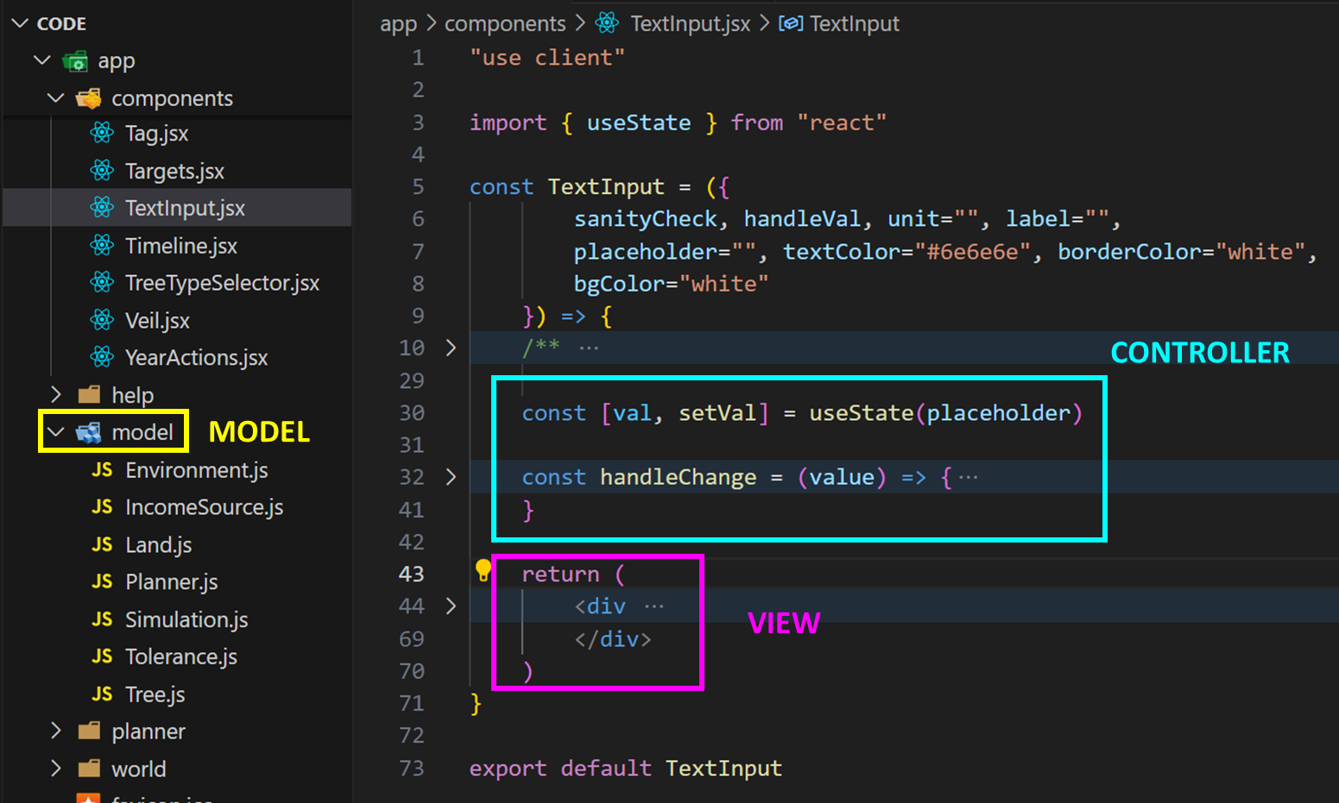
Design (viii)
AVOIDING COMMON PITFALLS
BAD DESIGN ELEMENT |  | COUNTER MEASURES TAKEN
RIGIDITY | Difficult to change. | Separation of concerns by sticking to the Model View Controller design pattern. Underlying model is separate from React components and is organized into classes in an Object Oriented Fashion.
FRAGILITY | Prone to breaking. | Modular testing (app and specific components tested immediately after implementation of each new feature). GitHub for version control. Lessen rigidity.
IMMOBILITY | Difficult to reuse. | Choice to use ReactJS allows for creation of reusable components. Example: <Button/>, <Switch/>, <Card/>, <Veil/>, etc.
VISCOSITY | Hacks over the right thing. | Temporary fixes were avoided or immediately replaced as soon as correct solution was identified. Example: Decision to change structure of code early on and start afresh instead of continuing work on initial prototype code.
Model View Controller

Slide 20
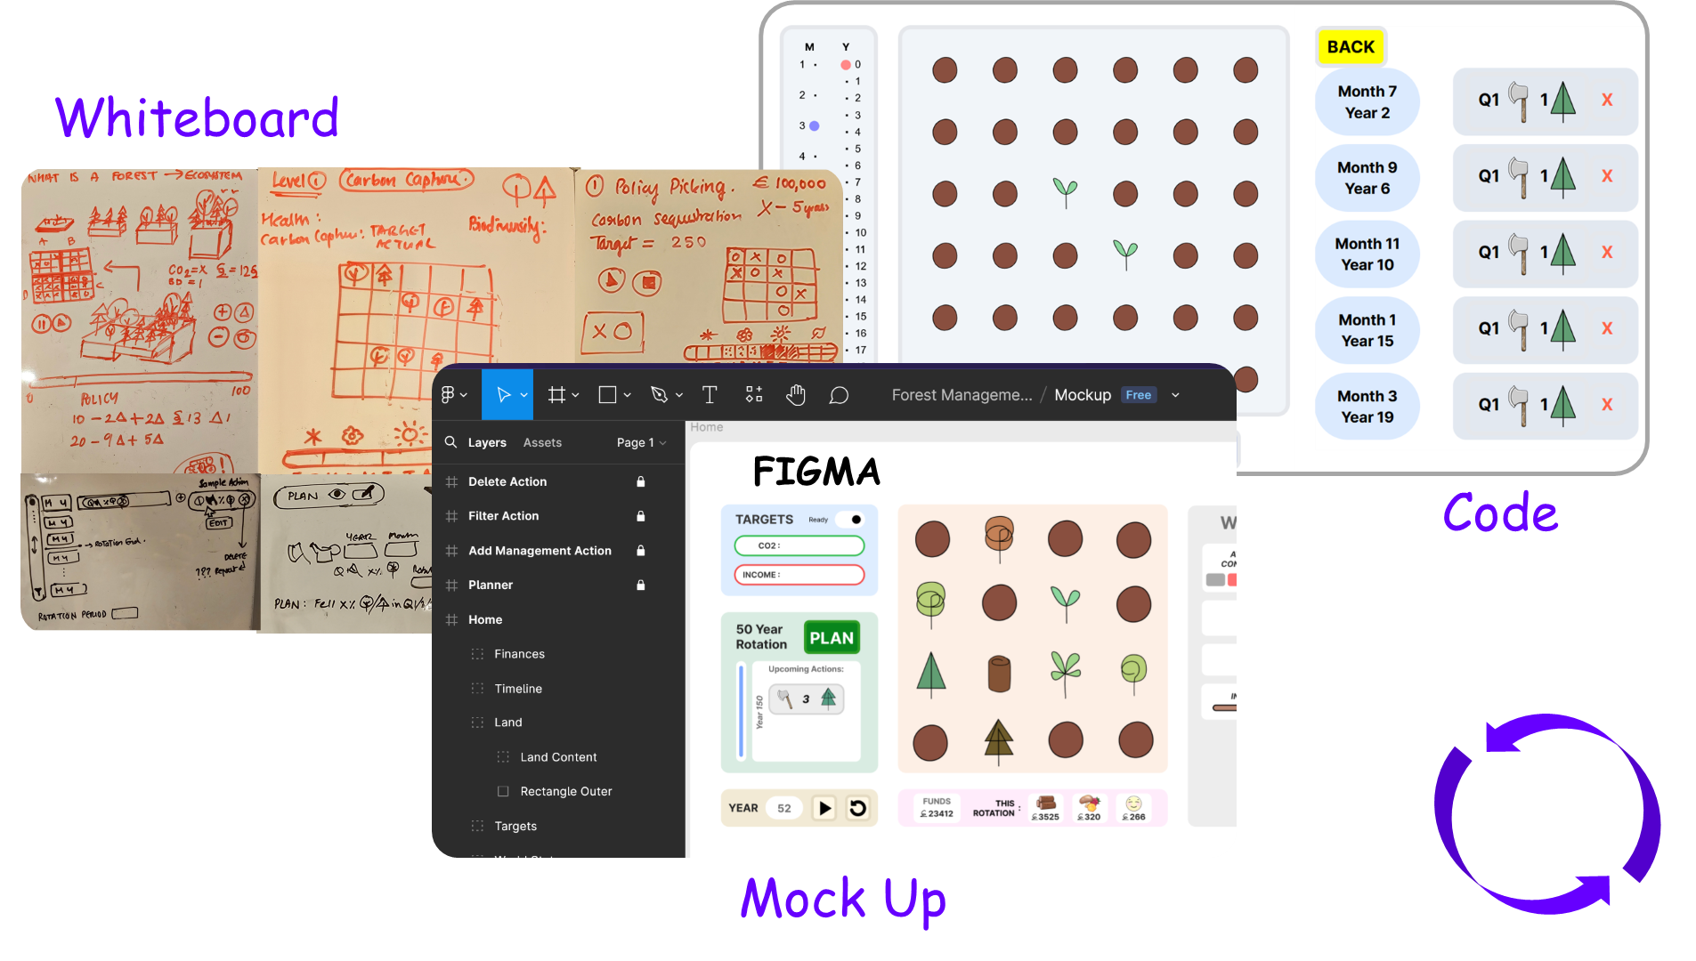
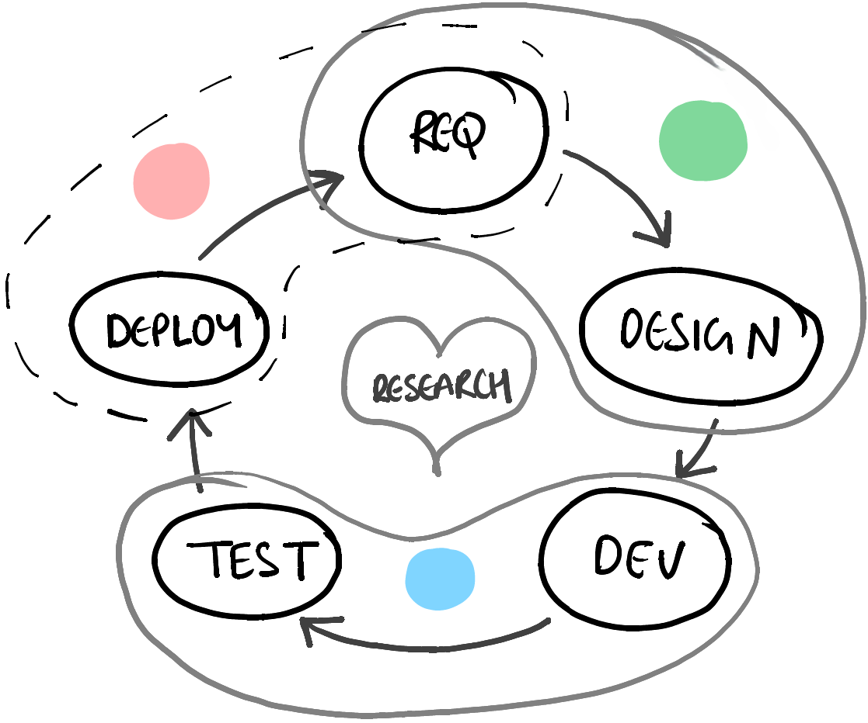
Design (ix)
STAYING AGILE
Deployment
& Analysis
Planning
Iterative Development
Frequent Feature Delivery,
Feedback and Improvement
Building
CICD Pipeline Set Up using &
GitHub
Vercel

Slide 21
Design (x)
SOME PROJECT-SPECIFIC CHALLENGES
PROBLEM: Precision issues when working with astronomically large numbers.
SOLUTION: Big.js library.
PROBLEM: Integrating D3.js v7 with NextJS technologies.
SOLUTION: Research + documentation + trial an error.
PROBLEM: Rigidity of software. Difficult to change.
SOLUTION: Move key variables to a separate environment file. Enforce Model View Controller design pattern.
PROBLEM: Getting the carbon cycle to keep CO2 concentration levels in balance.
SOLUTION: Consult co-supervisor. Research to arrive at real world numbers and maintaining ratios.
PROBLEM: Global values must be influenced by absorption and release from only 36 trees.
SOLUTION: Scale carbon absorbed and released by a fixed factor. Find right value through trial and error.
PROBLEM: Difficult to keep track of all model rules and design choices.
SOLUTION: Organize documentation corresponding to each interconnected component in graph format. I used Obsidian to do this.

Slide 22
Demo
https://microworld-dissertation-tcd.vercel.app/

Slide 23
Evaluation Plan (i)
Questionnaire: The form that the students filled in, comprised 16 UIUX related questions as defined in the widely used product satisfaction questionnaire, the PSSUQ. These are Likert scale questions with 1 (min) being strongly agree and 7 (max) being strongly disagree.
Additionally, 10 custom questions (6 Likert scale questions and 4 open-ended questions) regarding educational experience and attitude towards climate change was added to the questionnaire.
Please find this questionnaire here.
Triangulation: Feedback from tutors at the event and a domain expert in Botany shall also be collected.
The Mycroforest teaching tool was used for a 2 hrs session as part of a two-day workshop on Climate Change and Sustainability with (n=10) TY students on the TAP Bridge2College Programme.
Learning Activity:
Introduction (explanation by tutors and a short video).
Challenge 1 – Each team of students try to earn as much as they can from timber without worrying about CO2 emissions.
Discussion.
Challenge 2 – Each team of students try to keep atmospheric CO2 levels as low as they can and compare their new plan with the one from the previous challenge.
Discussion.
.
Questionnaire

Slide 24
Evaluation Plan (ii)
BRIDGE TO COLLEGE LEARNING SESSION RESULTS
Please find a summary of student feedback here.
Satisfaction: Overall positive response.
UIUX: Positive overall. 3 students suggest that the system throw more error messages. “Simplicity” and “Ease of use” were among most popular best aspects of the app as per student comments while suggestions for improvement included more help and error messages along with expansion of scenarios.
Learning & Value: All students agree that such apps make learning more engaging. All but 1 student agree that they found the experience and app valuable. “Very Informative” was among student comments.
Attitude Towards Climate Change & Forest: Interestingly, while most students were just as (5/10) or more (3/10) concerned about climate change after the use of the app as they were before. Concern level for 2 students dropped after use of the app. The reason may be increased confidence in use of forests as a carbon sink, but this is interesting and warrants further investigation.

Slide 25
What did I learn?
URGENCY OF NEED FOR ACTION AGAINST RAPIC CLIMATE CHANGE
FORESTY PRACTICES, INCOME STREAMS, AND ROLE OF FORESTS AS CARBON SINKS
FEATURES OF EFFECTIVE EDUCATIONAL TOOLS
JOY OF SHARING KNOWLEDGE
OBJECT ORIENTED PROGRAMMING IN JAVASCRIPT
IMPORTANCE OF DOCUMENTATION & SOFTWARE DEVELOPMENT BEST PRACTICES
ADVANTAGE OF AGILE DEVELOPMENT METHODOLOGY
APP EVALUATION
ANOTHER CHANCE TO APPLY CONCEPTS FROM THE ADVANCED SOFTWARE ENGINEERING MODULE

Slide 26
Conclusion
ACHIEVEMENTS & LIMITATIONS
ACHIEVEMENTS | LIMITATIONS
A functional teaching tool that students found informative, fun, and simple to use. | Although capture real world trends and behaviour via rules, not scientifically accurate (e.g. CO2 concentration in air fluctuates more than it does on earth in real life, ocean carbon reservoir not considered).
Got to apply software development theory. | Should throw error messages.
Got to experience product evaluation process. | Need to update help to be more informative and noticeable.
Got to help teach something and leaned about methods for effective teaching/learning. | Evaluation consisted of just 10 learners. This is not statistically significant for which at least 30 individuals are required.
Learned a lot about forests and their importance in the fight against rapid climate change.
Developed better appreciation for complexity of the natural world.
Furthered skill in use of NextJS, ReactJS, HTML, JavaScript, CSS, D3.js and Tailwind CSS.
Learned about the Big.js library

Slide 27
REFERNCES (i)
[1] Adam Daigneault et. al., “How the future of the global forest sink depends on timber demand, forest management, and carbon policies,” Global Environmental Change Human and Policy Dimensions, 2022. 76., vol. 76, p. 1–13, 2022.
[2] J. Fergesen, “Trees Help Protect the Planet From Climate Change. But The World Isn’t Doing Enough to Protect Forests,” TIME, 18 October 2022. [Online]. Available: https://time.com/6213444/how-do-trees-affect-climate-change/. [Accessed 25 June 2024].
[3] C. Anders, “World breaks 1,400 temperature records in a week as heat waves sweep globe,” semafor, 23 June 2024. [Online]. Available: https://www.semafor.com/article/06/23/2024/world-breaks-1400-temperature-records-heat-waves-sweep-globe. [Accessed 25 June 2024]
[4] E. Helmore, “Heatwave continues to roast 65m people in US midwest and north-east,” The Guardian, 24 June 2024. [Online]. Available: https://www.theguardian.com/environment/article/2024/jun/21/heatwave-midwest-north-east. [Accessed 25 June 2024].

Slide 28
REFERNCES (ii)
[5] European Commission, “Consequences of climate change,” European Commission, [Online]. Available: https://climate.ec.europa.eu/climate-change/consequences-climate-change_en#threats-to-business. [Accessed 25 June 2024].
[6] A. Moseman, “What is the ideal level of carbon dioxide in the atmosphere for human life?,” Climate Portal MIT, 18 May 2021. [Online]. Available: https://climate.mit.edu/ask-mit/what-ideal-level-carbon-dioxide-atmosphere-human-life. [Accessed 25 June 2024].
[7] Myles Allen et. al., “Frequently Asked Questions,” Intergovernmental Panel on Climate Change (IPCC), 2018. [Online]. Available: https://www.ipcc.ch/site/assets/uploads/sites/2/2018/12/SR15_FAQ_Low_Res.pdf. [Accessed 25 June 2024].
[8] T. Fouqueray, J. Latune, M. Trommetter and N. Frascaria-Lacoste. Interdisciplinary modeling and participatory simulation of forest management to foster adaptation to climate change. Environmental Modelling &amp; Software 2022 Vol. 151 Pages 105338.DOI: 10.1016/j.envsoft.2022.105338. https://dx.doi.org/10.1016/j.envsoft.2022.105338

Slide 29
REFERNCES (iii)
[9] C. Garcia and E. Speelman. 2017. Landscape Approaches, Wicked Problems and Role Playing Games. DOI: 10.13140/RG.2.2.26134.24644. https://www.researchgate.net/publication/320170969_Landscape_Approaches_Wicked_Problems_and_Role_Playing_Games.
[10] P. O. Waeber, M. Melnykovych, E. Riegel, L. V. Chongong, R. Lloren, J. Raher, et al. Institution: MDPI AG 2023. Fostering Innovation, Transition, and Reconstruction of Forestry: Critical Thinking and Transdisciplinarity in Forest Education with Strategy Games. DOI: 10.20944/preprints202305.1718.v1. https://dx.doi.org/10.20944/preprints202305.1718.v1
[11] Myles Allen et. al., “Frequently Asked Questions,” Intergovernmental Panel on Climate Change (IPCC), 2018. [Online]. Available: https://www.ipcc.ch/site/assets/uploads/sites/2/2018/12/SR15_FAQ_Low_Res.pdf. [Accessed 25 June 2024].
[12] C. Hoyles, R. Noss and R. Adamson. 2002. Rethinking the Microworld Idea. Journal of Educational Computing Research Vol. 27 Issue 1 Pages 29-53. DOI: 10.2190/u6x9-0m6h-mu1q-v36x. https://journals.sagepub.com/doi/abs/10.2190/U6X9-0M6H-MU1Q-V36X

Slide 30
REFERNCES (iv)
[13] L. P. Rieber. Cambridge Handbook of Multimedia Learning 2005. Multimedia Learning in Games, Simulations, and Microworlds. http://lrieber.coe.uga.edu/mayer2005/
[14] S. Dabholkar. Northwestern University Ph.D. 2021. Restructurating Science Learning with Emergent Systems Microworld (ESM)-based Learning Environments. https://www.proquest.com/docview/2618538356?pq-origsite=gscholar&fromopenview=true&sourcetype=Dissertations%20&%20Theses
[15] G. K. Lilian. Education for Sustainable Development Pedagogy in Pre-Primary Social Studies Curriculum in Kenya: Review of Literature. Journal La Edusci 2022 Vol. 3 Issue 3 Pages 1-12. DOI: 10.37899/journallaedusci.v3i3.662, https://dx.doi.org/10.37899/journallaedusci.v3i3.662

